Slide 1
BLOOD BANK MANAGEMENT SYSTEM
PAPER ID- 620

Slide 2
Blood Bank Management System
Group No: G12
Paper id: IACIT-2020-PID-620
Group Members
Snehasish Banik(R17CS403), rana2013.banik@gmail.com
Sriyansh Ghosh(R17CS410), hsriyanshghosh2000@gmail.com
TV Poonam (R17CS426), tvpoonam2000@gmail.com
Under the Guidance of
Prof. Laxmi Jayannavar

Slide 3
Contents
Problem Statement and Objectives
Related works
Proposed Work
Results and Discussion
Conclusion
References

Slide 4
Problem Statement and Objectives
The following problems occur in a typical blood donation management system:
Personal profile accessibility of donors profile.
Lost or damaged membership card can threatened the membership of the donor.
Donors may find it difficult to schedule their next appointment in case of losing membership card.
The donor not be notified of their blood result unless they request that information from the blood bank.

Slide 5
Problem Statement and Objectives(contd.)
The objectives of the Blood Bank Management System are as follows:
To provide a means for the blood bank to publicize and advertise blood donation programs.
To allow the probable recipients to make search and match the volunteer donors, and make request for the blood.
To provide an efficient donor and blood stock management functions to the blood bank by recording the donor and blood details.
To improve the efficiency of blood stock management by alerting the blood bank staffs when the blood quantity is below it par level or when the blood stock has expired.

Slide 6
Related works
In 2015, Sultan Turhan, proposed a real time android application that Blood donor volunteers constitute the main supply source in an effective blood supply chain management.
In 2014, T.Hilda Jenipha and R.Backiyalakshmi, they proposed a system which introduce connection of blood bank application with nearest hospitals.
In 2012, Vikas Kulshreshtha and Sharad Maheshwari, proposed a real time blood bank application that discuss about the benefits of management information system in blood bank.

Slide 7
Proposed Work
Given are the modules for the proposed Blood Bank.
Admin Module: In this module, the administration work is done such as insertion and updation of new details, deletion of old details and so on.
User Module: In this module, users use to do their task such as registering themselves as an account member, getting details by filtering of their own choices,
Database Module: Here, in this module, all the database is maintained and queries are being executed. Every database has its own table which contains rows and tuple and every relation is being handles using SQL queries, given either by user in the form of statement or else by admin.
Content Module: In this module, some basic content will be share after each time limit, for regular updation regarding blood disease and its curing periods.

Slide 8
Proposed Work(contd.)
If User is enrolled then give User Id (I) and secret key (P) else Create new record.
While blood stock gets low Send notice to contributors for blood gift camp.
If there is demand from client for blood, this will show in the database.
Check for blood accessibility at blood donation center.
If blood isn't accessible send notice from blood donation center to the enrolled Donors.
Check conditions for blood gift and different variables and past history.
If conditions are fulfilled acknowledge it.
If Conditions are not fulfilled at that point send warning to different contributors who are qualified

Slide 9
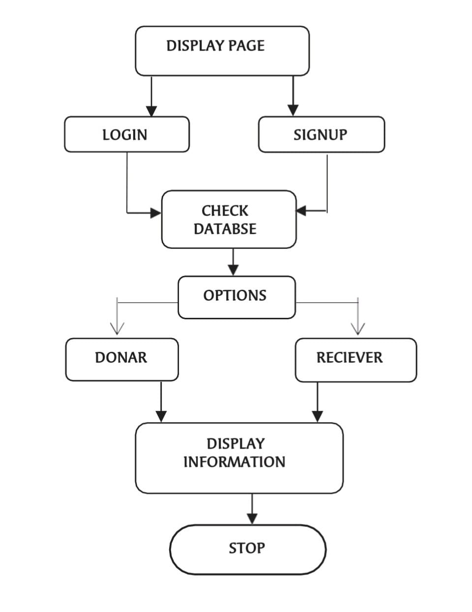
Proposed Work(contd.)
The following is the flow chart of the proposed system.

Slide 10
Pseudo-Code
<body>
<div class="login-page bk-img" style="background-image: url(img/banner.png);">
<div class="form-content">
<div class="container">
<div class="row">
<div class="col-md-6 col-md-offset-3">
<h1 class="text-center text-bold text-light mt-4x">Friends Blood Bank Sign in</h1>
<div class="well row pt-2x pb-3x bk-light">
<div class="col-md-8 col-md-offset-2">
<form method="post">
<label for="" class="text-uppercase text-sm">Your Username </label>
<input type="text" placeholder="Username" name="username" class="form-control mb">
<label for="" class="text-uppercase text-sm">Password</label>
<input type="password" placeholder="Password" name="password" class="form-control mb">
<button class="btn btn-primary btn-block" name="login" type="submit">LOGIN</button>
</form>
</div></div></div></div></div></div></div>
</body>

Slide 11
Results and Discussion
This Blood Bank system will specify all the details related to the donor such as their name, their address, their mobile number, their blood group and so on.
The one who need blood, just have to login into the system.
One who needs the blood get access to all the details of those who can donate blood in urgent.
It stores all the information in a database which is verify information and can be seen through hard and fast the months with no issue.

Slide 12
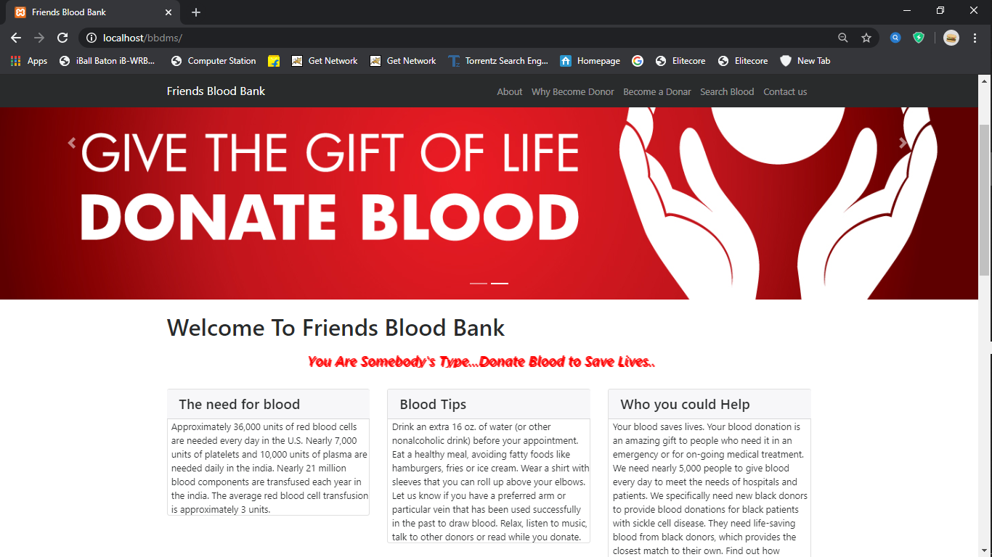
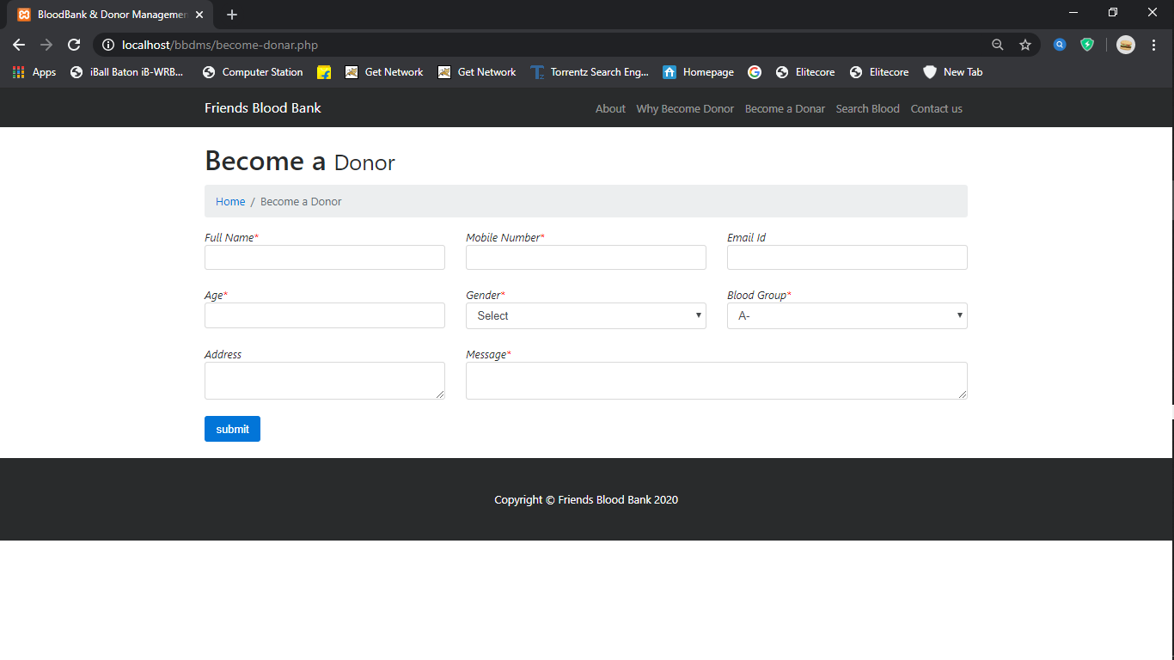
Results and Discussion(contd.)
The following are some snapshots of our work.

Slide 13
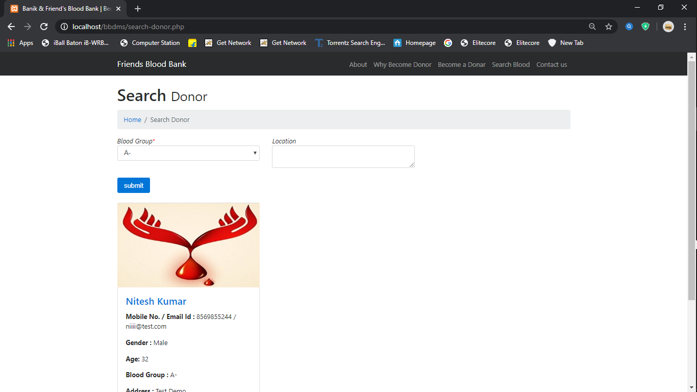
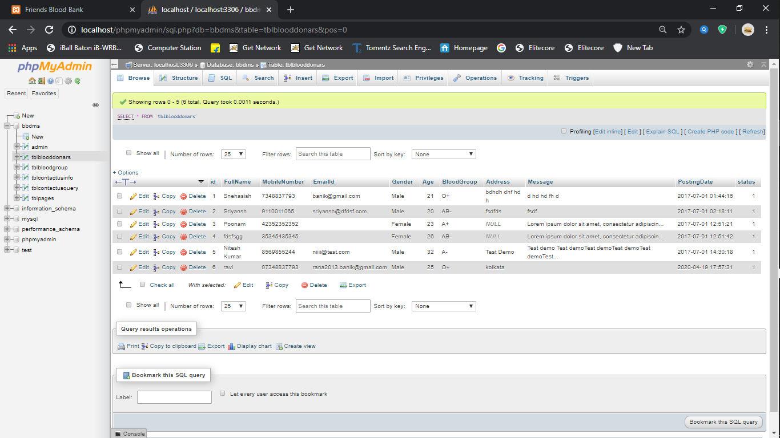
Results and Discussion(contd.)

Slide 14
Conclusion
The proposed Application is easy to understand and simple to use.
All the informations of donor and receiver are stored in the database.
The Problem of finding bloods of rare blood groups can easily be solved.
The reports area shows the month wherein blood bunch are being appropriated and gotten.
The receiver can easily contact the blood donor as all donor information will be provided in the application.

Slide 15
References
VikasKulshreshtha and Sharad Maheshwari, “Benefits of Management Information System in Blood Bank”, International Journal of Engineering and Science, Vol. 1, Issue 12, PP 05-07, 2012.
Hayes, Helen and Onkar Sharma, "A decade of experience with a common first year program for computer science, information systems and information technology majors". Journal of Computing Sciences in Colleges, Vol. 18, No. 3 pp. 217–227, 2003.
Polack, Jennifer, "Planning a CIS Education Within a CS Framework". Journal of Computing Sciences in Colleges, Vol. 25, No. 2, pp. 100–106, 2009.

Slide 16


